Slide 1
Car Evaluation
By Yuhan Meng,Xueqian Zhang, Yuhang Lan

Slide 2
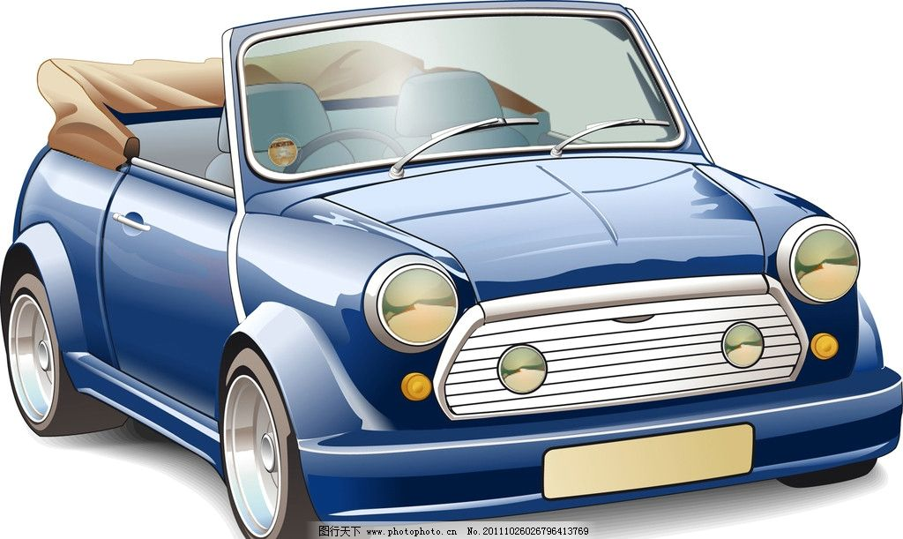
Car Evaluation
Data Resource
Data Displaying & Processing
Fit Models
Model Selection
Feature Selection

Slide 3
Data Resource

Slide 4
-Data Resource
Data Set: Car Evaluation Data Set
Information: Car Evaluation from UCL machine learning repository, which is derived from simple hierarchical decision model.
Online resource: http://mlr.cs.umass.edu/ml/machine-learning-databases/car/
Creator: Marko Bohanec
Donors: 1. Marko Bohanec (marko.bohanec @ijs.si) 2. Blaz Zupan (blaz.zupan @ijs.si)

Slide 5
Data Displaying & Processing

Slide 6
-Data Displaying & Processing
Number of Instances:1728
Number of Attributes:6
-buying: vhigh,high.med,low
-maint:vhigh,high,med,low
-doors:2,3,4,5more
-persons:2,4,more
-lug_boot:small,med,big
-safety:low,med,high
Class Labels:unacc,acc,good,vgood

Slide 7
-Data displaying & processing
First 9 lines of our data
buying | maint | doors | persons | Lug-boot | safety | label
vhigh | vhigh | 2 | 2 | small | low | unacc
vhigh | vhigh | 2 | 2 | small | med | unacc
vhigh | vhigh | 2 | 2 | small | high | unacc
vhigh | vhigh | 2 | 2 | med | low | unacc
vhigh | vhigh | 2 | 2 | med | med | unacc
vhigh | vhigh | 2 | 2 | med | high | unacc
vhigh | vhigh | 2 | 2 | big | low | unacc
vhigh | vhigh | 2 | 2 | big | med | unacc
vhigh | vhigh | 2 | 2 | big | high | unacc

Slide 8
-Data Displaying & Processing
Since we will use k-NN to get one of our models, we transform the dataset and use it to fit k-NN model:
buying | Low→0 | Med→1 | High→2 | Vhigh→3
maint | Low→0 | Med→1 | High→2 | Vhigh→3
doors | 2→2 | 3→3 | 4→4 | 5more→5
persons | 2→2 | 4→4 | More→6
Lug_boot | small→0 | Med→1 | Big→2
safety | Low→0 | Med→1 | High→2
Class Labels | Unacc→0 | Acc→1 | Good→2 | Vgood→3

Slide 9
Goal: Try to find the best model to fit our dataset!

Slide 10
Models:
Models
k-NN
Decision tree
Bagging with k-NN
CV with k-NN
Random forest
Ordinal Regression
CV with decision tree

Slide 11
-Data split
Test data 20%
Valiation data 10%
Training data 70%

Slide 12
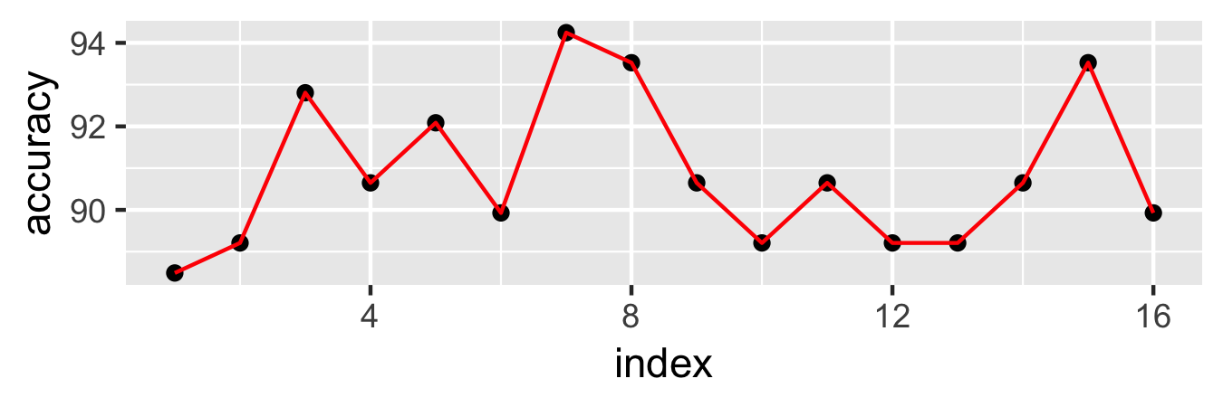
-Model 1:k-NN
K-value | 1 | 2 | 3 | 4 | 5 | 6 | 7 | 8
accuracy | 88.4892 | 89.2086 | 92.8058 | 90.6475 | 92.0863 | 89.9281 | 94.2446 | 93.5252
K-value | 9 | 10 | 11 | 12 | 13 | 14 | 15 | 16
accuracy | 90.6475 | 89.2086 | 90.6475 | 89.2086 | 89.2086 | 90.6475 | 93.5252 | 89.9281

Slide 13
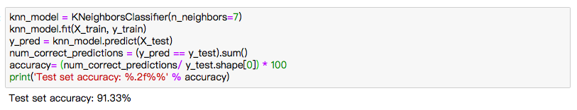
-Model 1:k-NN
K-value | 1 | 2 | 3 | 4 | 5 | 6 | 7 | 8
accuracy | 88.4892 | 89.2086 | 92.8058 | 90.6475 | 92.0863 | 89.9281 | 94.2446 | 93.5252
K-value | 9 | 10 | 11 | 12 | 13 | 14 | 15 | 16
accuracy | 90.6475 | 89.2086 | 90.6475 | 89.2086 | 89.2086 | 90.6475 | 93.5252 | 89.9281

Slide 14
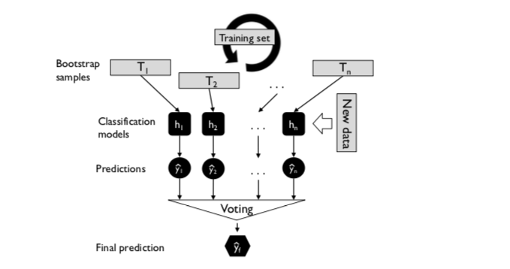
-Model 2: Bagging with k-NN
200 bootstrap samples for each k value(k=1…16)
Get the prediction via majority voting

Slide 15
- Model 2: Bagging with k-NN
K-value | 1 | 2 | 3 | 4 | 5 | 6 | 7 | 8
accuracy | 94.2446 | 87.7690 | 93.5252 | 89.2086 | 94.2446 | 90.6475 | 93.5252 | 92.0863
K-value | 9 | 10 | 11 | 12 | 13 | 14 | 15 | 16
accuracy | 92.8058 | 92.0863 | 92.0863 | 91.3669 | 92.0863 | 92.0863 | 91.3669 | 91.3669
When k=1, because it is then just memorizing the training datasets, and if query point is near a noise point, k-NN will predict the label of the noise point in all cases, which leads to increased overfitting and bad generalization performance. Hence, it is generally better to increase k to limit the influence of noise points on the decision boundary.

Slide 16
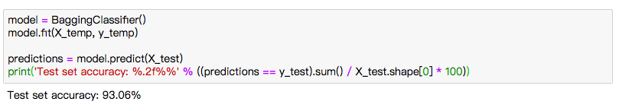
- Model 2: Bagging with k-NN
K-value | 1 | 2 | 3 | 4 | 5 | 6 | 7 | 8
accuracy | 94.2446 | 87.769 | 93.5252 | 89.2086 | 94.2446 | 90.6475 | 93.5252 | 92.0863
K-value | 9 | 10 | 11 | 12 | 13 | 14 | 15 | 16
accuracy | 92.8058 | 92.0863 | 92.0863 | 91.3669 | 92.0863 | 92.0863 | 91.3669 | 91.3669
When k=1, because it is then just memorizing the training datasets, and if query point is near a noise point, k-NN will predict the label of the noise point in all cases, which leads to increased overfitting and bad generalization performance. Hence, it is generally better to increase k to limit the influence of noise points on the decision boundary.

Slide 17
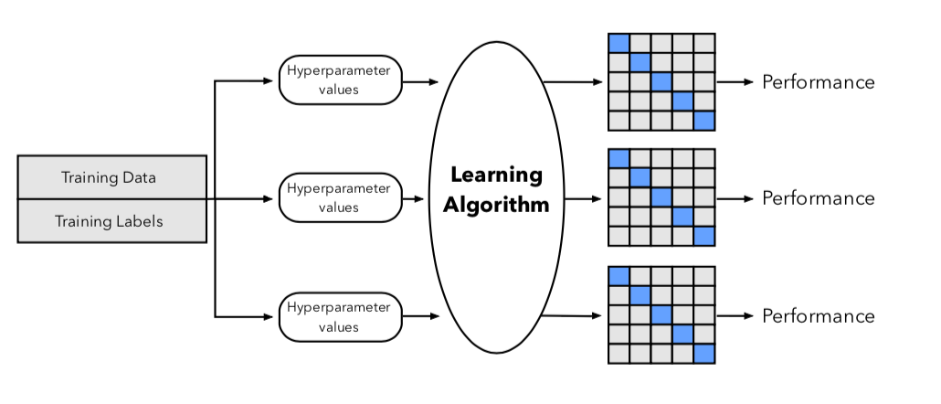
- Model 3: 10 Fold CV with k-NN
…

Slide 18
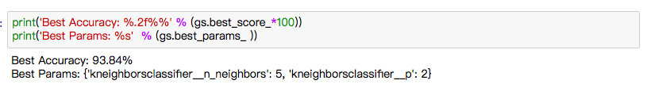
- Model 3: 10 Fold CV with k-NN
…

Slide 19
- Model 3: 10 Fold CV with k-NN
…

Slide 20
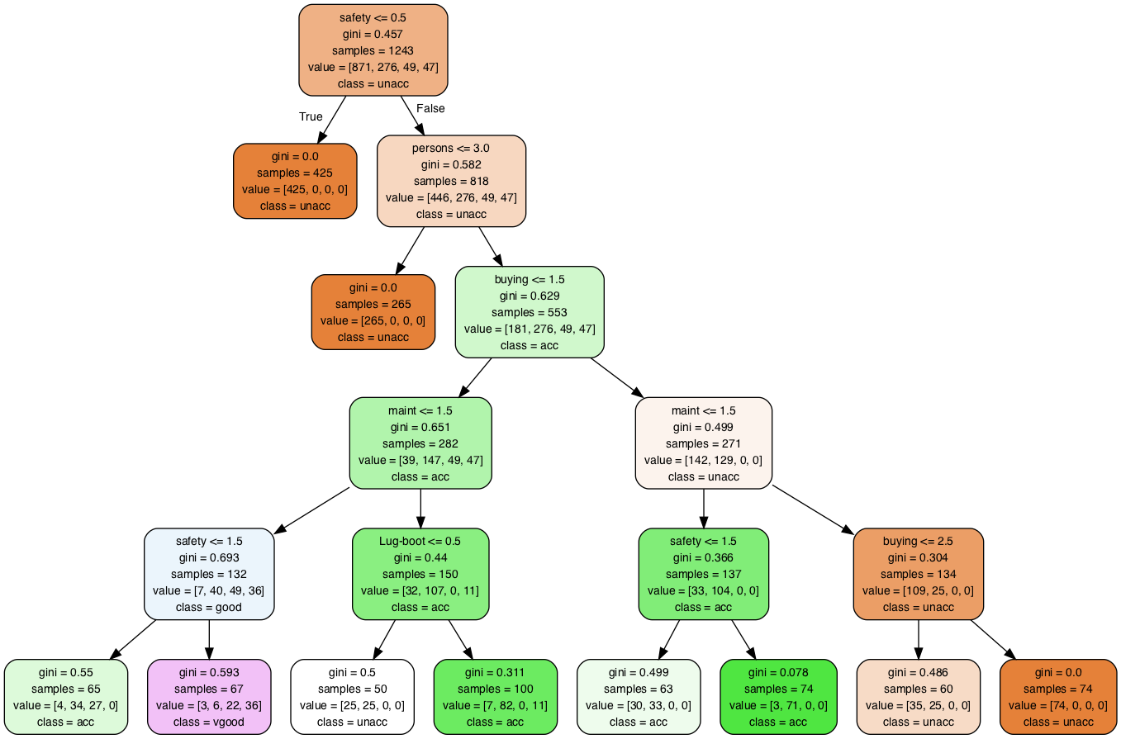
- Model 4: Decision Tree

Slide 21
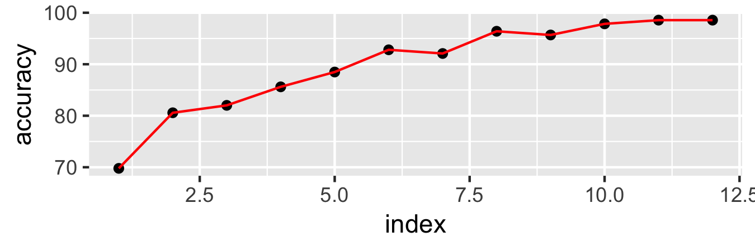
-Model 4: Decision Tree (Gini)
Max_Depth | 1 | 2 | 3 | 4 | 5 | 6
accuracy | 69.7842 | 80.5755 | 82.0144 | 85.6115 | 88.4892 | 92.8058
Max_Depth | 7 | 8 | 9 | 10 | 11 | 12
accuracy | 92.0863 | 96.4029 | 95.6835 | 97.8417 | 98.5612 | 98.5612

Slide 22
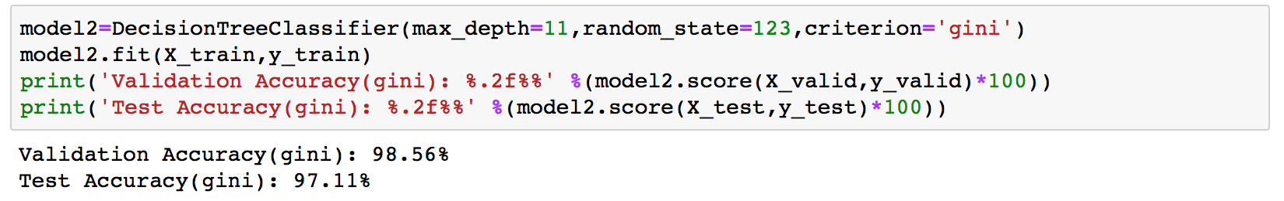
-Model 4: Decision Tree (Gini)
Max_Depth | 1 | 2 | 3 | 4 | 5 | 6
accuracy | 69.7842 | 80.5755 | 82.0144 | 85.6115 | 88.4892 | 92.8058
Max_Depth | 7 | 8 | 9 | 10 | 11 | 12
accuracy | 92.0863 | 96.4029 | 95.6835 | 97.8417 | 98.5612 | 98.5612

Slide 23
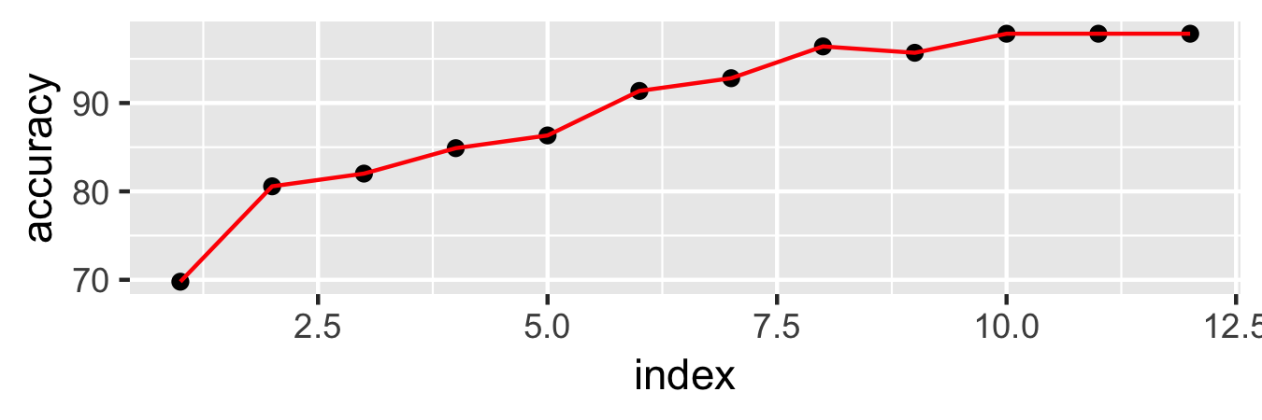
-Model 4: Decision Tree (Entropy)
Max_Depth | 1 | 2 | 3 | 4 | 5 | 6
accuracy | 69.7842 | 80.5755 | 82.0144 | 84.8921 | 86.3309 | 91.3669
Max_Depth | 7 | 8 | 9 | 10 | 11 | 12
accuracy | 92.8058 | 96.4029 | 95.6835 | 97.8417 | 97.8417 | 97.8417

Slide 24
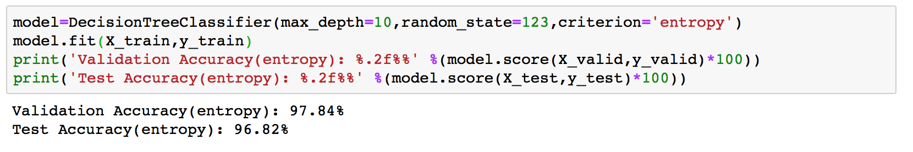
-Model 4: Decision Tree (Entropy)
Max_Depth | 1 | 2 | 3 | 4 | 5 | 6
accuracy | 69.7842 | 80.5755 | 82.0144 | 84.8921 | 86.3309 | 91.3669
Max_Depth | 7 | 8 | 9 | 10 | 11 | 12
accuracy | 92.8058 | 96.4029 | 95.6835 | 97.8417 | 97.8417 | 97.8417

Slide 25
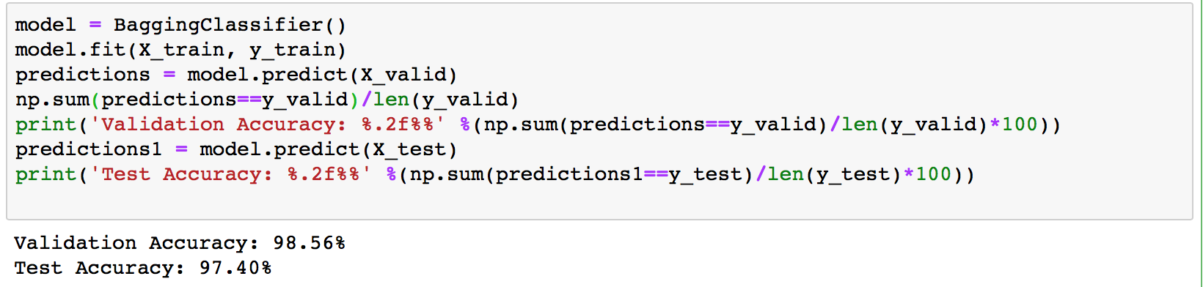
-Model 5: Random Forest
Fit 200 bootstrap samples for 200 individual tree classifiers
Get the prediction via majority voting

Slide 26
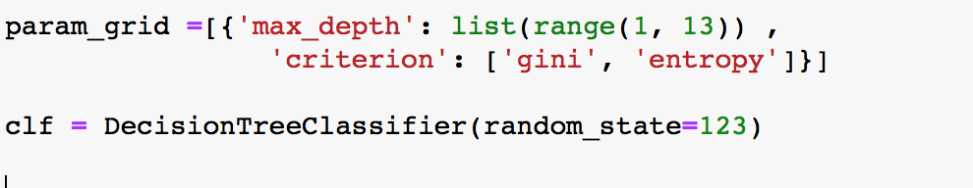
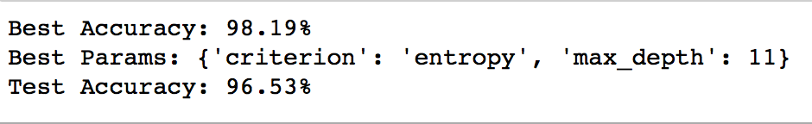
- Model 6: 10 Fold CV with Decision Tree
…

Slide 27
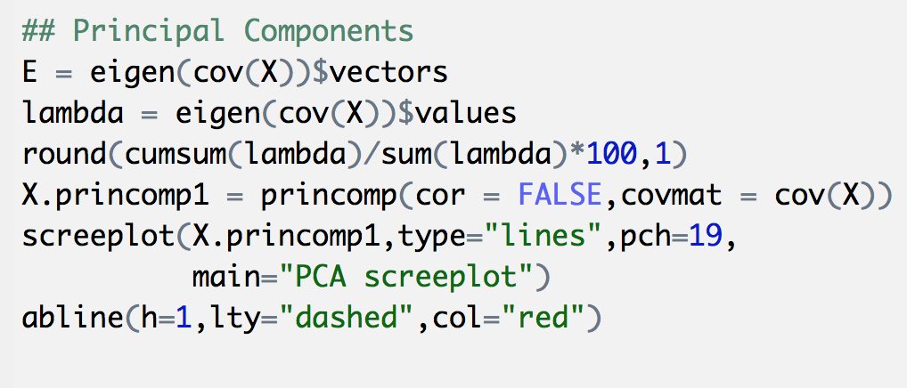
Feature selection: Random forest

Slide 28
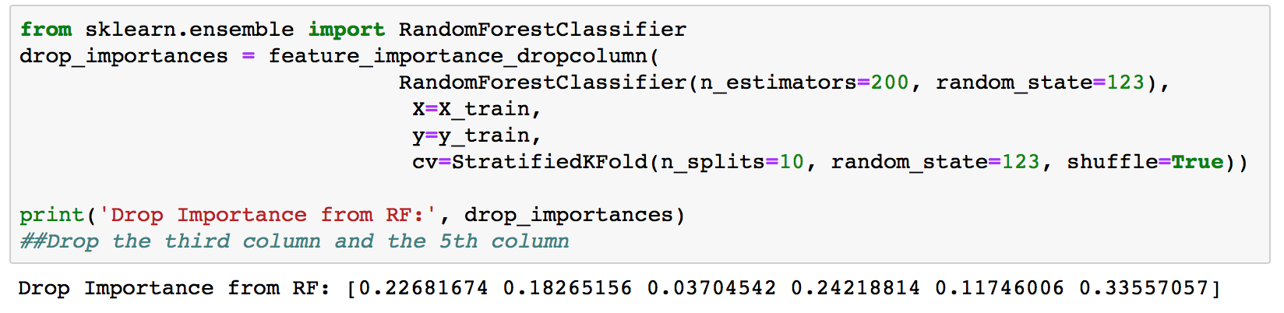
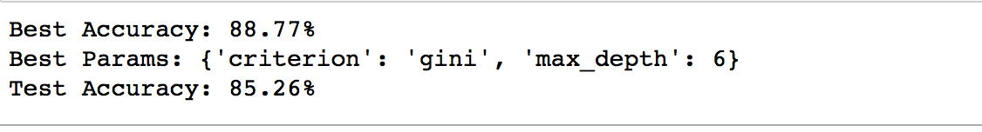
Feature selection: Random forest

Slide 29
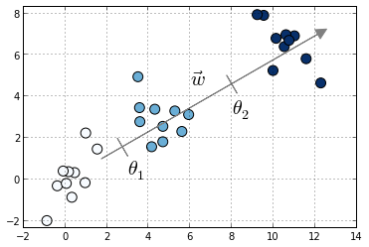
- Model 7: Ordinal Regression

Slide 30
- Model 7: Ordinal Regression
Motivation : ordered response
Class Labels : unacc , acc , good , vgood
polr(class ~ safety + lug_boot + doors + buying + maint, data=trainingData , Hess=T)

Slide 31
- Model 7: Ordinal Regression
 | TRUE: good
PREDICT | unacc | Not prefered
 | acc | prefered
Class Labels : unacc , acc , good , vgood
polr(class ~ safety + lug_boot + doors + buying + maint, data=trainingData , Hess=T)

Slide 32
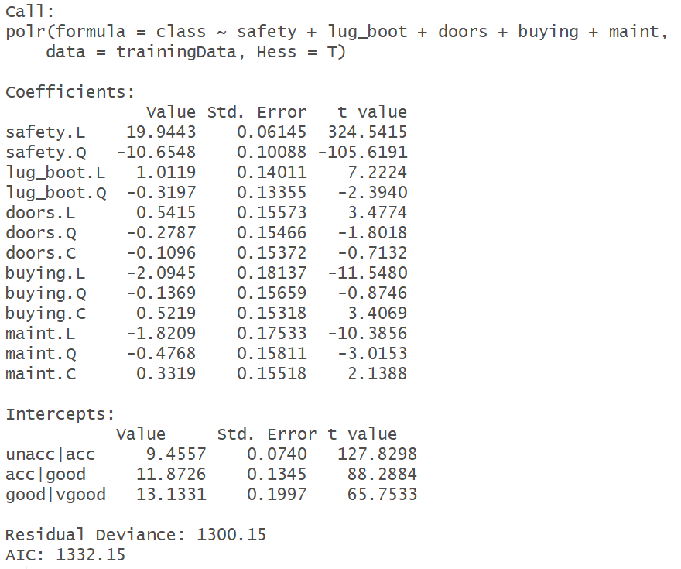
- Model 7: Ordinal Regression
Predict and Confusion matrix
 | Predicted Class
Actual class |  | Unacc | Acc | Good | Vgood
 | Unacc | 305 | 45 | 0 | 4
 | Acc | 60 | 60 | 0 | 0
 | Good | 0 | 17 | 0 | 0
 | Vgood | 0 | 18 | 0 | 10

Slide 33
- Model 7: Ordinal Regression
Predict and Confusion matrix
 | Predicted Class
Actual class |  | Unacc | Acc | Good | Vgood
 | Unacc | 305 | 45 | 0 | 4
 | Acc | 60 | 60 | 0 | 0
 | Good | 0 | 17 | 0 | 0
 | Vgood | 0 | 18 | 0 | 10
Accuracy = 0.7225

Slide 34
- Model 7: Ordinal Regression
Predict and Confusion matrix
 | Predicted Class
Actual class |  | Unacc | Acc | Good | Vgood
 | Unacc | 305 | 45 | 0 | 4
 | Acc | 60 | 60 | 0 | 0
 | Good | 0 | 17 | 0 | 0
 | Vgood | 0 | 18 | 0 | 10
Accuracy = 0.7225
MSE = 0.4432

Slide 35
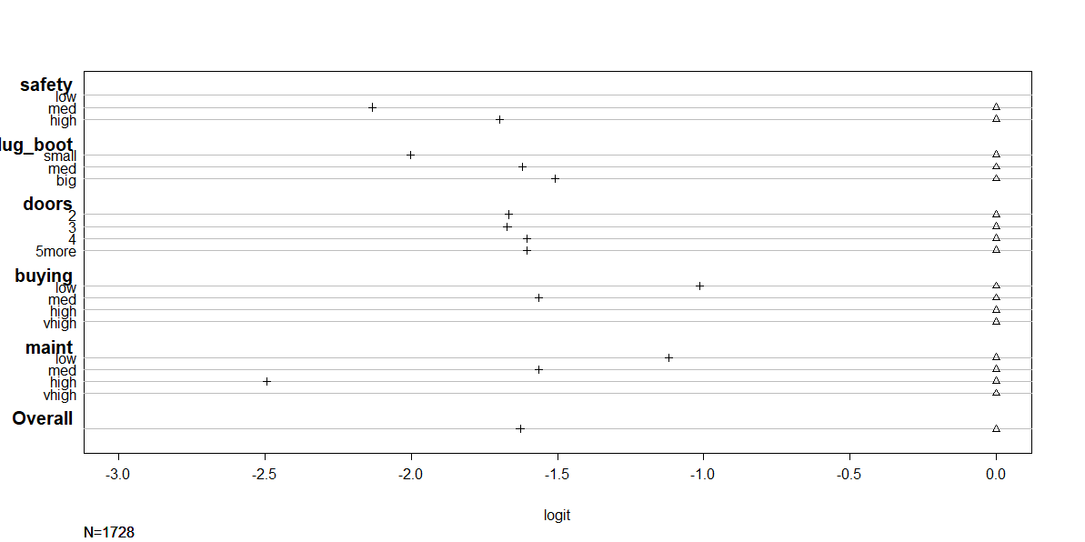
- Model 7: Ordinal Regression
Model Diagnostics

Slide 36
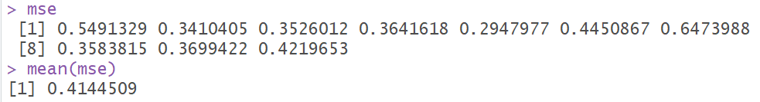
- Model 7: Ordinal Regression
10 fold cross validation
1 | 2 | 3 | 4 | 5 | 6 | 7 | 8 | 9 | 10
0.549 | 0.341 | 0.353 | 0.364 | 0.295 | 0.445 | 0.647 | 0.358 | 0.370 | 0.422

Slide 37
Model Selection

Slide 38
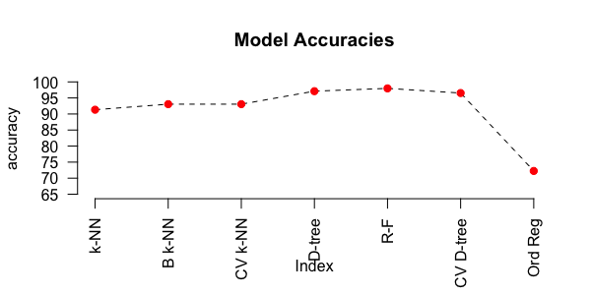
-Model Selection
Model | K-NN(k=7) | Bagging with k-NN(k=5) | 10 Fold CV with k-NN(k=5) | Decision tree | Random forest | CV with decision tree | Ordinary Regression
Accuracy(%) | 91.33 | 93.06 | 93.06 | 97.11 | 97.40 | 96.53 | 72.25

Slide 39
Thank you !

